Slide 1
Nature Disclosure and Strategies Nicole Hardiman, Ph.D. Nature Standards Lead

Slide 2
Housekeeping
Please feel free to add questions to chat. I will pause throughout.
For unanswered questions, I will generate answers and send to Sebastien.
Slides will also be emailed.

Slide 3
Agenda
Why nature?
How is nature defined?
TNFD overview
SBTN overview
CDP's expanded scope
CDP’s recommended next steps on nature

Slide 4
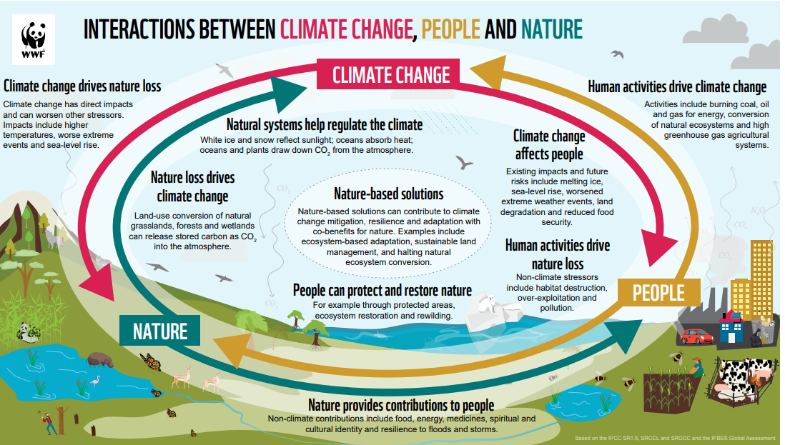
What is the relationship between people, nature, and climate?
Notes:
Nature loss and climate change cannot be separated.
The realms highlighted by the TNFD all interact with climate.
Achieving nature positive is impossible without addressing climate change.
Climate change is a key driver of biodiversity loss.
Nature loss releases emissions, amplifying climate change, which in turn drives further loss of species and ecosystems.
As these natural sinks are put under stress, their capacity to absorb carbon weakens, shifting them to become carbon sources . Climate change and nature loss are therefore mutually reinforcing.
Failure to account for nature undermines net zero, encouraging the trajectory towards irreversible tipping points.
Nature also has a role in climate change adaption strategies through the provision of ecosystem services and resilience to the significant climate change we are already committed to.
Enhancing the adaptive capacity of ecosystems, reduces the severity of climate change impacts.
Due to these feedback loops, a strategic approach of integrating nature with net zero goals needs to be taken.
References:
TNFD (2022) The TNFD Nature-related risk and opportunity management and disclosure framework.
IPCC, 2022: Summary for Policymakers
Gatti, L.V., Basso, L.S., Miller, J.B. et al. Amazonia as a carbon source linked to deforestation and climate change. Nature 595, 388–393 (2021). https://doi.org/10.1038/s41586-021-03629-6
IPCC, 2022: Summary for Policymakers
Lovejoy, T. and Nobre, C. Amazon Tipping Point, Science Advances, Vol 4, Issue 2, DOI: 10.1126/sciadv.aat2340

Slide 5
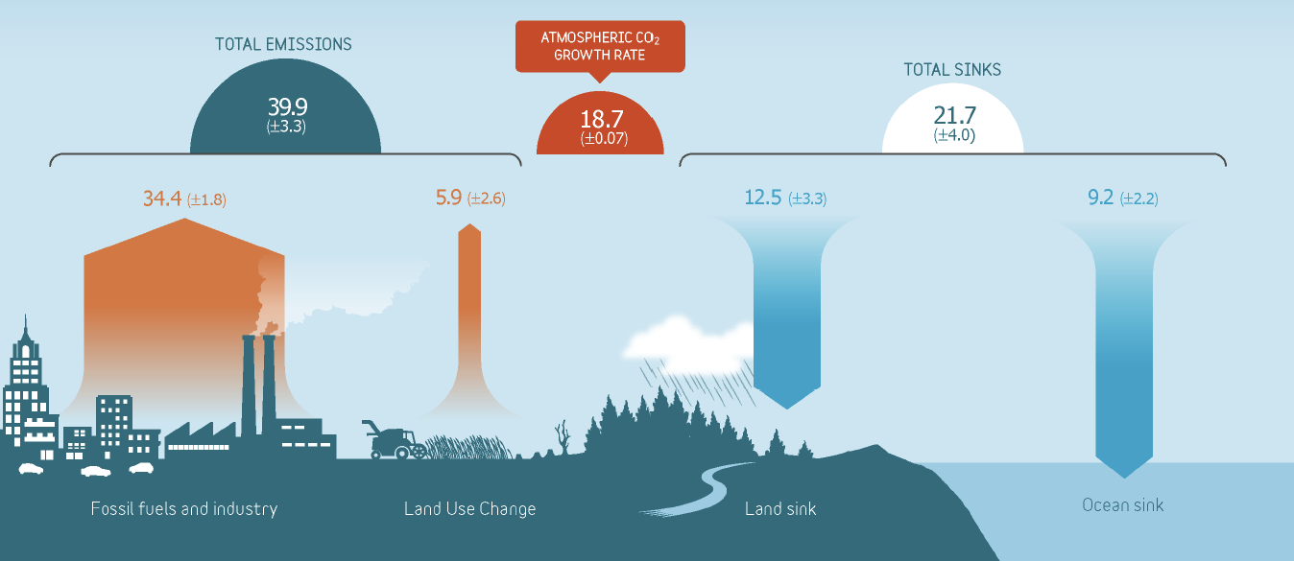
What is the relationship between people, nature, and climate?
Figures in B tons of CO2/year, average 2010 to 2019. From Friedlingstein, P. et al. (2022) Global Carbon Budget 2021. Earth Syst. Sci. Data 14(4): 1917-2005

Slide 6
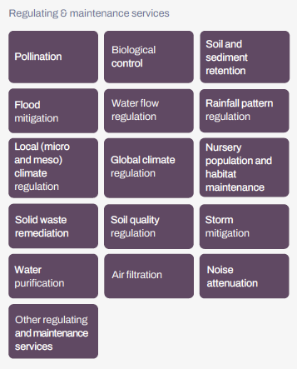
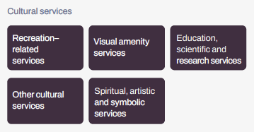
What is the relationship between people, nature, and climate?
$44 T of GDP (nearly 50%) is dependent on the services nature provides.
(World Economic Forum & PwC, 2020)

Slide 7
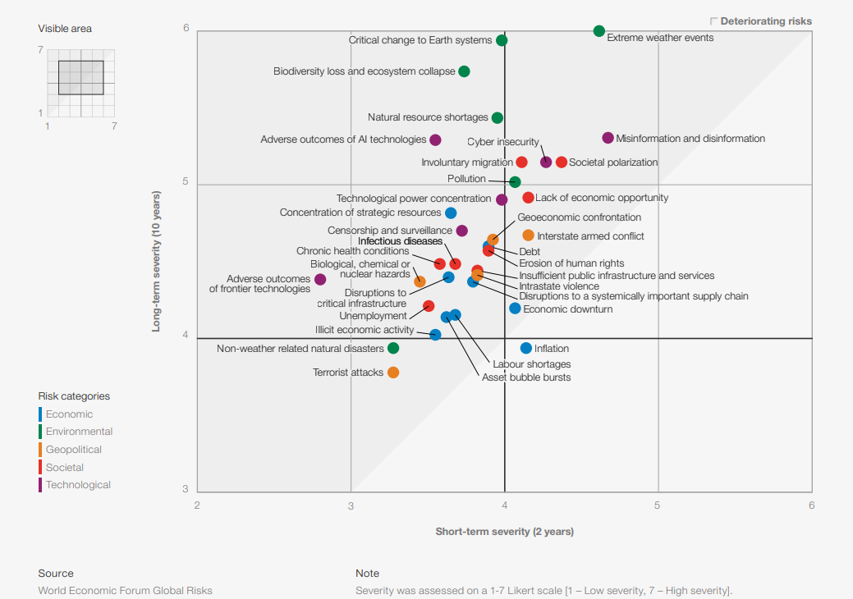
Nature loss recognized as a systemic risk
Global Risks Report: Relative severity of risks over a 2- and 10-year period
IPBES, 2019:
75% land and 66% marine ecosystems significantly altered.
1/3 global land and 3/4 freshwater resources devoted to agriculture.
23% global land degraded.
1 million species at risk of extinction.
Notes:
Key messages:
Nature loss is a significant global risk.
As a systemic risk – this translates into physical and transition risks.
Companies disclosing show that they recognise nature loss as a systemic risk which they are exposed to and will need to manage.
--------
Biodiversity and ecosystem collapse has been rising up the annual WEF Global Risks Report in terms of impact and likelihood almost every year. It is now perceived as the most severe global risk within the next 10 years.
In 2020, for the first time, the World Economic Forum’s annual Global Risks Report found that the top five most likely global risks over the next 10 years are all environmental. Among these, biodiversity loss and ecosystem collapse are considered highly likely to occur and would have severe impacts.
Most of the attempts to quantify the importance of nature focus on the economic impacts of losses:
The first estimates of this came from the UNEP Economics of Ecosystems and Biodiversity (TEEB) work of the late 2000s
In summary – losses to biodiversity, ecosystems and ecosystem services represent huge financial risks
Such calculations can be good for highlighting economically invisible issues. But it should also be remembered these are always going to be gross underestimates.
The true value of nature is far more existential – without functioning ecosystems there would be no people

Slide 8
Agenda
Why nature?
How is nature defined?
TNFD overview
SBTN overview
CDP's expanded scope
CDP’s recommended next steps on nature

Slide 9
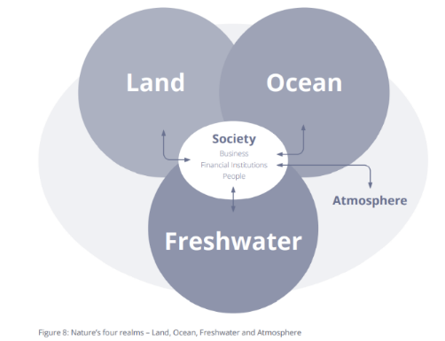
How to define nature?
“the natural world, with an emphasis on the diversity of living organisms (including people) and their interactions among themselves and with their environment.” (TNFD, 2022).
2 components of each realm:
Living:
Biodiversity
Species Abundance
Non-living:
Ecosystem condition
Notes:
The working definition of nature in the TNFD framework is the natural world, with an emphasis on the diversity of living organisms (including people) and their interactions among themselves and with their environment.
People and societies interact with nature and are not separate from it.
Nature can be understood through a construct of four realms – Land, Ocean, Freshwater and Atmosphere with biodiversity being present in each of these. These are major components of the natural world that differ fundamentally in their organisation and function.
Atmosphere is included in the framework to reflect the close association between climate- and nature-related risks and opportunities, while also acknowledging that links with climate mitigation and adaptation occur across all realms.
Biodiversity is considered an essential characteristic of nature that enables ecosystem assets to be productive, resilient and able to adapt to change.
Inset box:
But, as we know, nature can be a complex topic, so TNFD has provided further definitions and clarification around how companies and FI’s can evaluate and nature within their direct operations and supply chains (or investment portfolios). Essentially, companies and FI’s need to evaluate nature-based impacts, dependencies, risks, and opportunities against their economic activities and upstream supply in both qualitative and quantitative ways.

Slide 10
What are impacts and dependencies?
Five human-induced pressures to nature: land/sea use and change, direct exploitation, climate change, pollution and invasive species (IPBES, 2019)
Changes in natural capital
State of nature
These impacts influence the state of nature.
Indicators:
ecosystem structure, composition, function
population size and extinction risk
Business activity
Impact driver
Ecosystem services
Changes in ecosystem services affect the business’s dependencies. E.g., provisioning services, regulating and maintenance services, cultural services.
Sources: TNFD, SBTN, Leach et al., 2019, ESRS
Notes:
What exactly are impacts, dependencies, risks and opportunities?
Defining impact and dependencies:
Human activities (including companies' business activities) lead to land use change, pollution or natural resource use. Impacts drivers are defined by the IPBES (referred to by TNFD, SBTN, ESRS, WWF).
These impact drivers lead to changes in natural capital which eventually affects the provision of ecosystem services provided by these natural capital assets. (TNFD)
These impacts influence the state of nature.
Certain indicators are used to compare the current state of the ecosystem to a reference state or baseline.
They look at ecosystem extent, condition and functioning, and population size and extinction risk for impact on species. (SBTN, TNFD. ESRS 4)
Changes in ecosystem services affect the business’s dependencies. These are aspects of ecosystem services which a company relies on to function.
Dependencies include ecosystems’ ability to regulation of water quality, maintenance of soil quality or provision of certain crops. (cited by ESRS 4, TFND, SBTN)
The idea is that impacts are interconnected to dependencies due to feedback loops (CDBS, 2021).

Slide 11
What are risks and opportunities?
Five human-induced pressures to nature: land/sea use and change, direct exploitation, climate change, pollution and invasive species (IPBES, 2019)
Risks to nature
Changes in natural capital
State of nature
These impacts influence the state of nature.
Indicators:
ecosystem structure, composition, function
population size and extinction risk
Business activity
Impact driver
Ecosystem services
Opportunities for:
Operational and product efficiency
Conservation & Restoration
Reputation & Regulatory
Risks to business
Changes in ecosystem services affect the business’s dependencies (e.g., provisioning, regulating, maintaining and cultural services).
Sources: TNFD, SBTN, Leach et al., 2019, ESRS
Notes:
Defining risks and opportunities:
Generally there are two forms of risk (especially when thinking from a double materiality perspective).
Impact drivers create risks to nature in the form of exerting additional pressures, which could lead to additional changes to the state of nature, natural capital, and quantities or functioning of ecosystem services.
Those changes to the state of nature can subsequently create risks to businesses if the economic activities of the business are highly dependent on nature.
Opportunities can be viewed as the optimistic side of risk and really any risk can be turned into an opportunity. There are six types of opportunities that are regularly referred to: operational or product efficiency, opportunities to build reputation or gain a leg-up on regulatory developments. And, as for opportunities for nature, the opportunity to conserve or restore ecosystem function, biodiversity, natural capital, and ecosystem services.

Slide 12
Questions?

Slide 13
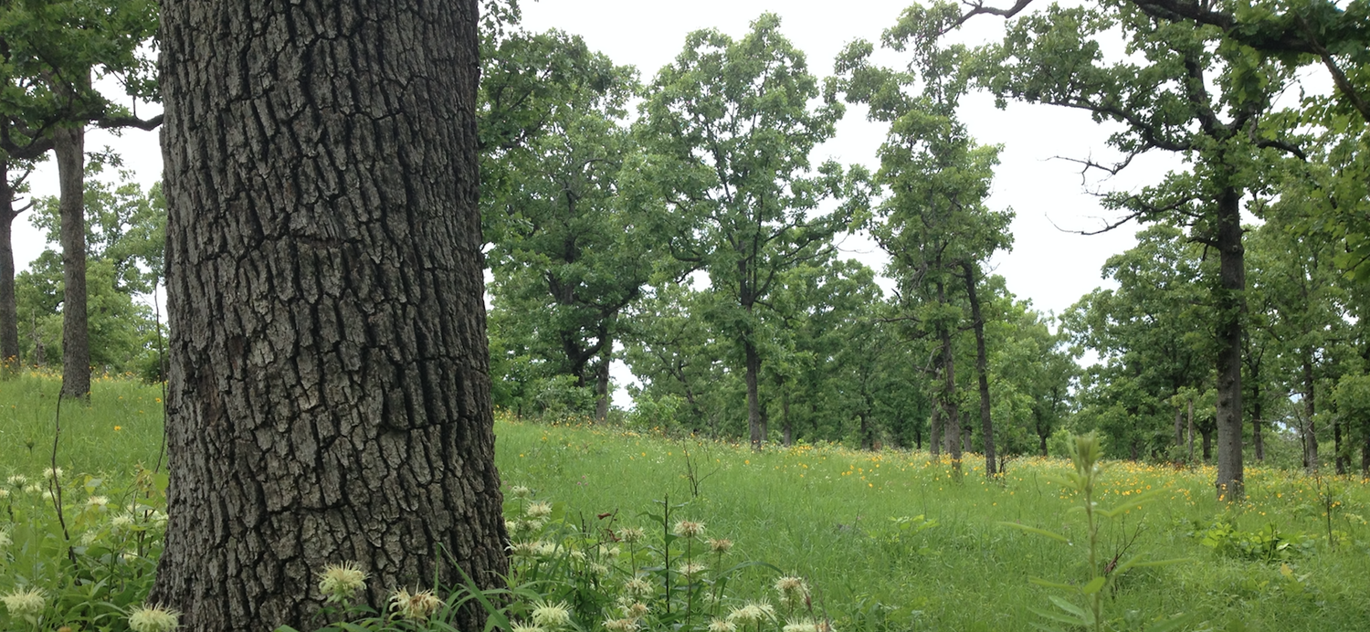
Why TNFD & SBTs for Nature?
What parts of nature are material for our company?
How do we describe the change?
How do we relate the changes to our economic activities?
How do we quantify the impact?
How do we address the issue?
How do we describe and quantify improvement?
How do we know the actions we take are high quality?
TNFD
Photo: Southeastern Grasslands Initiative
SBTs for Nature
Photo: Arkansas Farm Bureau
Notes:
As you probably know, human activities have significantly altered the functioning of the natural world and the species that reside within it. According to the Intergovernmental Platform on Biodiversity and Ecosystem Services, 75% of land and 66% of marine ecosystems have been altered, which not only puts a large number of species at risk of extinction, but also alters the stability of the services that nature provides for us. It is estimated by the World Economic Forum that around ½ of global GDP is dependent on services such as pollination, carbon sequestration, flood mitigation, and climate regulation, among others. Most of the loss of biodiversity and ecosystem function attributed to human activity is attributable to the five activities listed here.
It’s important to focus these five key pressures when talking about Nature SBTs because they will essentially be the dependent variables that company will need to measure to set and act upon a target. Pressures are defined as anthropogenic activities that have changed the state of environment or direct changes to the structure, function, or composition of ecosystems.
For example, with climate change, we talk about tons of CO2 equivalents. With land use change, the measurement parameter will be area (hectares or acres) of land. With non-ghg air pollutants, will be ppm or ppb of NOX or SOX. The implication of this being that your company may need to examine across different pressure types AND may have multiple parameters within each pressure type (for example, land AND freshwater use or nitrogen AND phosphorous quantity.)
As a personal anecdote, I've included here an example from my native state of Arkansas in the U.S., which is quite rural and contains a lot of natural area and a lot of farming. In that area of the State, the original ecology was called "prairie-oak savannah", which is basically a mix of upland and wetland grasslands interspersed with large trees and some small forests. You can imagine that in this ecosystem originally, there was likely some steady-state composition of wildlife, birds, and bugs that were dependent on the presence of certain plant species, which were in turn dependent on the structure, water retention ability, and microbe composition of the soils beneath them.
This flat and open land made for great pasture and livestock lands for early homesteaders and now contains considerable amounts of cattle, pork, and poultry production. With conversion of this land, the composition of the whole ecosystem changes: soils, plants, and all of the wildlife contained within. The value that SBTs for Nature adds is to provide a method to measure not only impact, but also improvement. So, for example, if this farmer employs some regenerative agriculture practice that restores the original ecosystem function, there will be a consistent and numeric way to account for that practice and its benefit to that specific ecosystem.

Slide 14
Agenda
Why nature?
How is nature defined?
TNFD overview
SBTN overview
CDP's expanded scope
CDP’s recommended next steps on nature

Slide 15
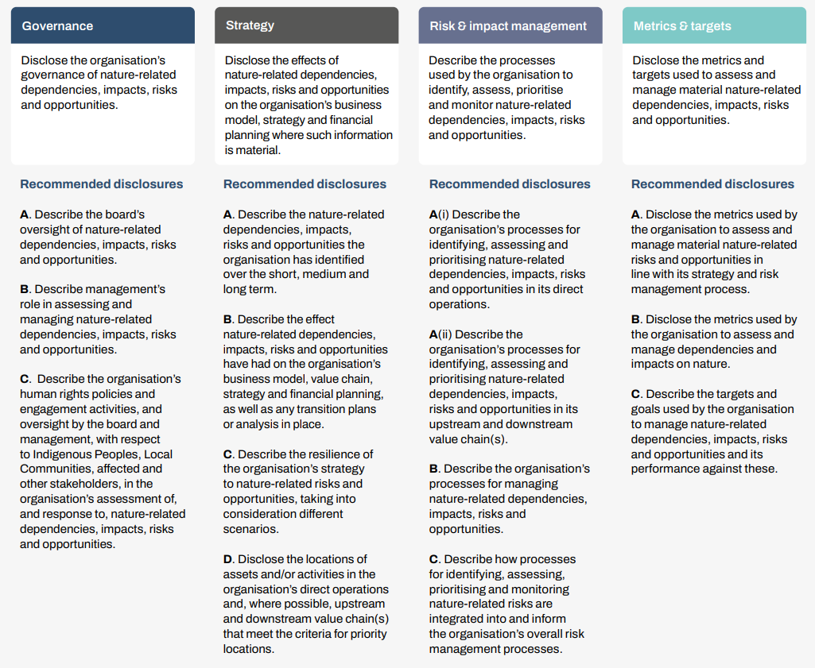
TNFD disclosure recommendations
Intended for public reporting
There is already significant alignment with CDP’s questionnaires due to longstanding alignment with the TCFD.
TCFD disclosure recommendations (in red) carried over to the TNFD
Adapted to better suit nature issues.
Four pillars, 14 recommended topics
Notes:
Zeroing in on the disclosure recommendations, there are 14 of them, you can see the pillars here should sound familiar if you’ve worked on the TCFD before.

Slide 16
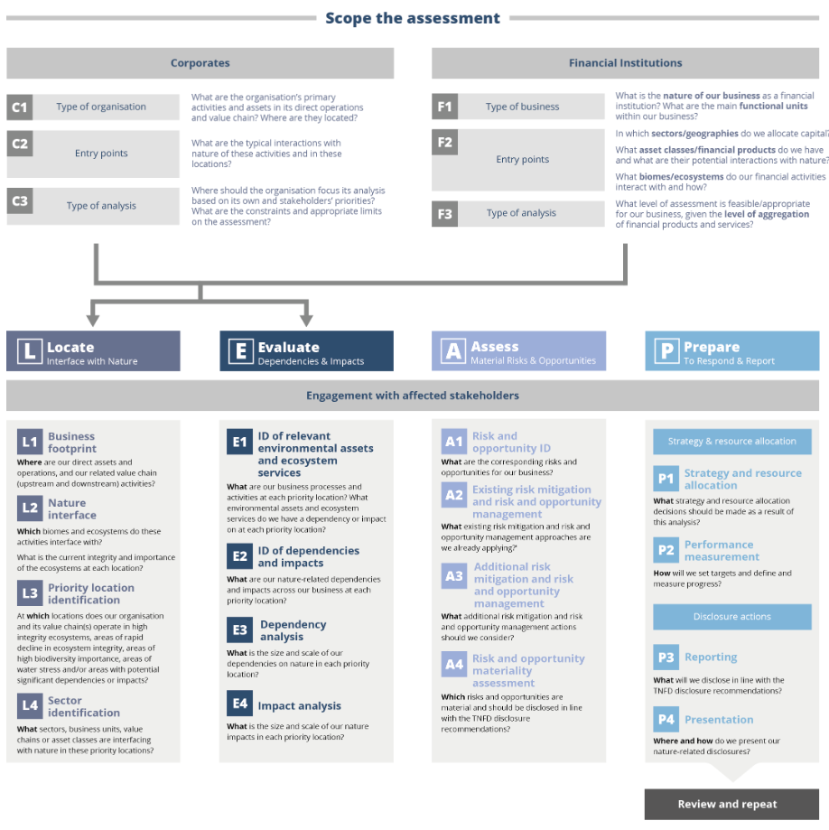
LEAP Framework:
Internal materiality assessment tool for companies to collect data and prepare to publicly disclose.
Four steps:
Locate
Evaluate
Assess
Prepare

Slide 17
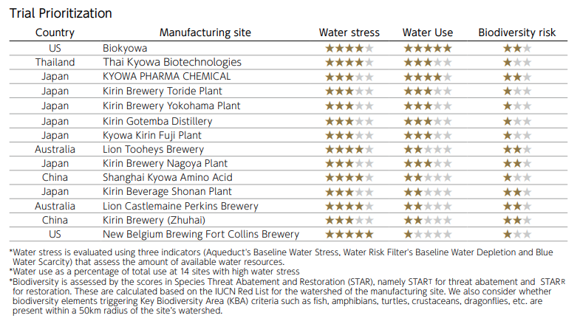
TNFD LEAP Approach: Evaluate
Impact assessment from Kirin, 2022

Slide 18
TNFD LEAP Approach: Evaluate
Adapted from TNFD Ecopetrol Pilot Report, 2022
Overall goal: ​
Deep dive risk and opportunity assessment for priority sectors, value chains, and geographies. ​
Risk | Risk Categories | Exposure Indicators | Likelihood | Magnitude Indicators
Conflict over water use | Transition Reputation | Amount and concentration of pollutants. Change in the median of species in water bodies. Increased socioenvironmental conflicts | Likely Possible Unlikely | Cost associated with relocation of assets. Reduced revenue due to disruption of operations Reduction in market valuation due to reputational impacts

Slide 19
TNFD LEAP Approach: Evaluate
Adapted from TNFD Ecopetrol Pilot Report, 2022
Opportunity | Risk Categories | Exposure Indicators | Likelihood | Magnitude Indicators
Restoration of La Doncella Ecoreserve | Resilience Reputation | Degraded area for restoration Improvement of ecosystem conditions Decrease in socio-environmental conflicts | Highly likely Highly likely Likely | Enhance resilience to natural disasters Market valuation boost Better stakeholder engagement Climate adaptation

Slide 20
Agenda
Why nature?
How is nature defined?
TNFD overview
SBTN overview
CDP's expanded scope
CDP’s recommended next steps on nature

Slide 21
What are SBTs for Nature?
“…measurable, actionable, and time-bound objectives, based on best available science…”
Integrated FLAG targets for land-based emissions
Preserving freshwater resources and water security
Supporting biodiversity and ecosystem services
Securing healthy, diverse oceans
Preserving and regenerating land systems
Four “hubs”/issue areas
Sets of targets within each issue area
Scope is direct operations and upstream supply chain stages (currently)
Target users are companies, independent of sector
Notes:
Similar to SBTs for Climate, SBTs for Nature are measurable, actionable, and time-bound objectives, based on best available science. The SBTs for Nature are being developed by an independent non-profit organization called Science Based Targets Network. There are “hubs” or working groups focused on four issue areas: freshwater, biodiversity, land, and oceans. Targets will be developed for each of the issue areas and one or more issue areas may not be applicable to some companies.
The current supply chain scope for target development is direct operations and upstream supply chain stages, but the goal is to address downstream impacts to nature in a later version. Also, target users are currently companies, but targets specifically for cities will also be addressed in a later version. And lastly, the targets are currently independent of sector, so there are no target sectors or sector-specific guidance.
SBTs for Nature are connected to SBTs for Climate and SBTi in that companies that want to set validated targets for land will be required to set FLAG targets for land based emissions, as well as set a zero deforestation goal (as required by setting a FLAG target). Additional land based targets designed by SBTN will focus on use, conversion of other important ecologies, and biodiversity.

Slide 22
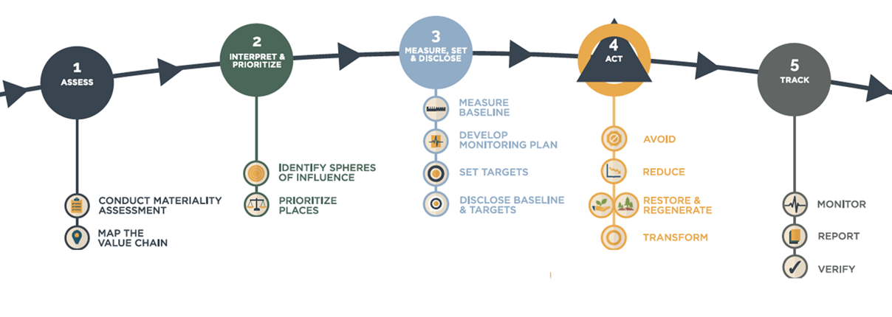
SBTN’s Five Step Process
Guidance for Steps 1 and 2 released May 2023
Notes:
SBTN outlines a five step process for creating, setting, and acting upon a target. Step 1 is a economic activity level analysis of a company’s impact to nature. This analysis will include all business units and include direct operations as well as upstream suppliers. If certain economic activities are found to be materially impactful to nature, this step then requires a mapping of ALL sites for direct operations and upstream suppliers (of high impact commodities) The output of Step 1 is a list of all possible nature based impacts based on location.
Step 2, the interpret and prioritize step, includes an assessment of the feasibility of acting upon each item in the list, as well as identification of the primary and secondary data sources available to the company. This can also include identification of data gaps: where a company needs data, but is not currently collecting it.
Detailed technical guidance is available for Steps 1 and 2 on SBTN’s website.

Slide 23
SBTN’s Five Step Process
Freshwater and land methods released with Steps 1 & 2; methods for oceans and biodiversity to follow.
Notes:
Step 3 is the target setting step, where the target is defined and plan for data collection and monitoring against the target is set.
Detailed technical methods are available for freshwater and land target setting on SBTN’s website. As previously mentioned, targets for all other issue areas (oceans and biodiversity) are forthcoming.

Slide 24
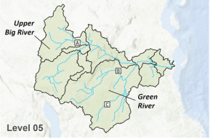
Step 3: Freshwater Target Setting
Preliminary analysis, targets, and long-term monitoring will be basin specific.
Two targets:
Green River
Upper Big River
Three possible target types:
Nitrogen
Phosphorus
Water withdrawal
Sites B & C: data aggregated
Site A: reported separately
Notes:
One of the most interesting aspects of science based targets for nature will be the spatially explicit component of target setting. It is likely that all issue areas will have some spatial analysis component.
For the example of freshwater targets, the spatial analysis will be based on locations within watersheds. If you are not familiar with the term “watershed”, it essentially means ‘the area of land that provides all surface runoff and subsurface waters to a given waterbody’. The targets will be specific to the watershed.
So, in this example here, if a company has three manufacturing sites (or three farms) in this watershed, it will need to set two targets: one for the Green River watershed and one for the Upper Big River watershed.
Additionally, the data from sites B and C will be aggregated to report against the Green River watershed and the data from only site A will be used to report against the Upper Big River watershed.
So, if sourcing from a water scarce region, the company may have a much higher percent reduction target than if sourcing water from a more water-plentiful watershed.

Slide 25
SBTN’s Five Step Process
Draft guidance for Steps 4 and 5 to be released in 2025
Notes:
Step 4 is the action step, where a company determines the actions that will be deployed to meet the target. And Step 5 includes implementation of the monitoring plan, as well as the report and disclosure portion of the process.
Detailed technical guidance is available for freshwater target setting on SBTN’s website. As previously mentioned, targets for all other issue areas (oceans, biodiversity, and land) are forthcoming.
It should also be mentioned these targets are meant to be validated at the time of establishment and a company will also need to have progress against their targets verified by a third party.

Slide 26
Questions?

Slide 27
Agenda
Why nature?
How is nature defined?
TNFD overview
SBTN overview
CDP's expanded scope
CDP’s recommended next steps on nature

Slide 28
CDP’s 2025 strategy
OUR VISION
We want to see a thriving economy that works for people and planet in the long term.
OUR ENVIRONMENTAL PRIORITIES
CDP’s environmental priorities are to support the following objectives being achieved in the world:
To reduce emissions in line with a 1.5ºC pathway
To restore ecosystem health
‘We will expand our work to cover the full range of planetary boundaries and earth systems…’
Notes:
CDP’s direction of travel in regards to nature is encapsulated by our vision and our environmental priorities as stated in CDP’s 2025 strategy, a world where emissions are reduced in line with 1.5 degrees and ecosystem health is restored.
Our new 2025 strategy sets out how CDP will respond to this. It sets out how we plan
To increase transparency
To hold actors to account on transitioning to net zero and nature positive
And how we plan to use disclosure to drive system change across the wider economy
CDP adopting ‘climate and nature’ approach – but recognise it is a false dichotomy.
CDP already covers climate and some ‘nature’ through the forests and water questionnaires
But various additional targets needed if we are going to better cover planetary boundaries:
Land use: Ecosystem conversion beyond forests, restoration
Marine changes: Not a planetary boundary but important?
Biodiversity / biosphere integrity: Intactness indices? Extinction rates?
Pollution: Plastics pollution, Organic pollution? Aerosol pollution?

Slide 29
Evolution of disclosure:
a holistic view of corporate action and impact
Scope – asking the right actors the right questions on the right issues
Rigour - ensuring the results we generate drive the change needed
Practicality – minimising reporting burden and maximising alignment
GHG
emissions
Water
extraction
New issue?
Freshwater
pollution
Land conversion
Biodiversity
Plastics
Environmental target
Oceans
Disclosed performance
3 separate questionnaires on climate, water and forests
A holistic, integrated, sector specific assessment across all issues of relevance
(integrated questionnaire)

Slide 30
Agenda
Why nature?
How is nature defined?
TNFD overview
SBTN overview
CDP's expanded scope
CDP’s recommended next steps on nature

Slide 31
Opportunities to take nature-based action
CDP
SBTi
TNFD
Wherever your company is on their sustainability journey,
there are immediate actions to take.
SBTN
(Science Based Target Initiative)
(Taskforce for Nature-related Financial Disclosures)
(Science Based Targets Network)
Disclose to CDP
Join the Reporter Services and Supply Chain programs
Setting an emissions reduction target
If applicable, set a FLAG target for land-based emissions
Start with the LEAP approach
Prepare to disclose using TNFD guidance
Join SBTN’s Corporate Engagement Program
Get started with Steps 1 and 2

Slide 32
Thank you!
Any questions?
Nicole Hardiman, Ph.D.
Nature Standards Lead

